Slide 1
Unit 3 R packages and scripts
Prof. Archana Magare

Slide 2
Contents
Installing and loading packages
Setting up your working directory
Downloading and importing data
Working with missing data
Extracting a subset of a data frame
Writing R scripts
Adding comments and documentation
Creating reports
Summary

Slide 3
Installing and loading packages.
All of the functions that you’ll want to use in R come in the form of packages. A package is a big collection of functions and other R objects that are all grouped together under a common name.
Some packages are pre-installed in R. To learn which packages are installed in your version of R, type:
library( )
For the data visualization course you’ll be required to use additional packages that are not loaded with R. For statistics you may want to download the psych package for additional statistical functions.

Slide 4
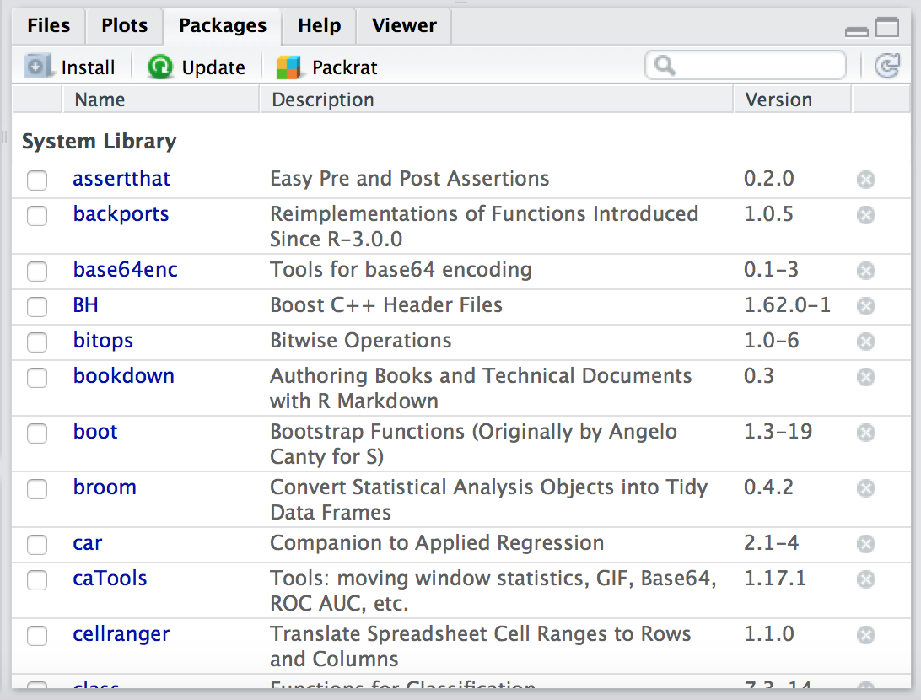
Installing packages.
Install two packages: psych and ggplot2. Select the packages tab from the lower right frame. This is called the files frame.

Slide 5
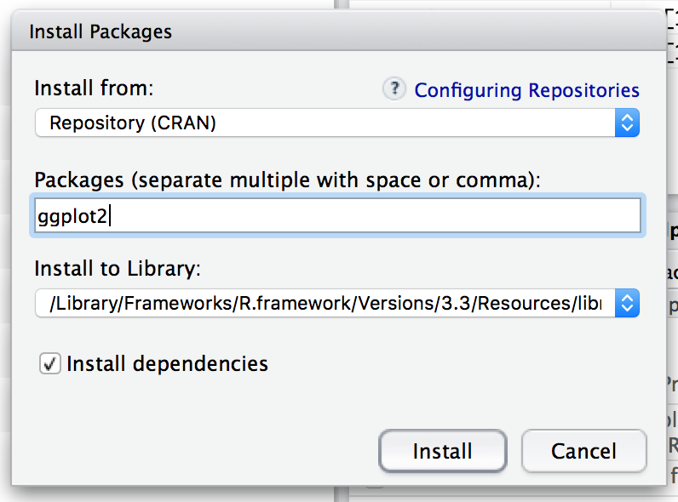
Installing packages.
This will bring up a dialog box similar to the one in Figure. The first drop down asks you from which R repository you would like to download a package. The default Repository(CRAN) will work well for our purposes. CRAN stands for the “Comprehensive R Archive Network” and it is usually easiest to download a package from one of the CRAN mirror sites. Ensure you are connected to the internet when installing packages. Next, enter the package name in the Packages field.
Enter: ggplot2, psych
Keep the rest of the options as they appear by default. Then click the install button.

Slide 6
Loading and unloading packages
To use a package that is new to your instance of R or not selected for use by default in RStudio you need to load the package. Simply go to the package tab in RStudio and check the box next to the packages you want to use. Select ggplot2 and psych
You could also type the command:
library(ggplot2)
## Warning in as.POSIXlt.POSIXct(Sys.time()): unknown timezone 'zone/tz/2019c. ## 1.0/zoneinfo/America/New_York‘
In the future this will be useful when you are writing lines of R code that you want to reuse. It will be helpful to know which libraries are being used and called upon that are not loaded by default in RStudio.

Slide 7
Setting your working directory
To work with dataset, first we have to set the working directory.
When working with data, it’s important to stay organized. You want to be able to easily find your files, scripts, graphs, etc. For purpose of this course, create a folder on your desktop (this is outside of RStudio) called mydata (or whatever works for you).
In R, set your working directory to a place where you will store all your data files. In our case, let’s set our working directory to that mydata folder you created on your desktop. This way any time you want to open a file, R will know where to look (and so will you).

Slide 8
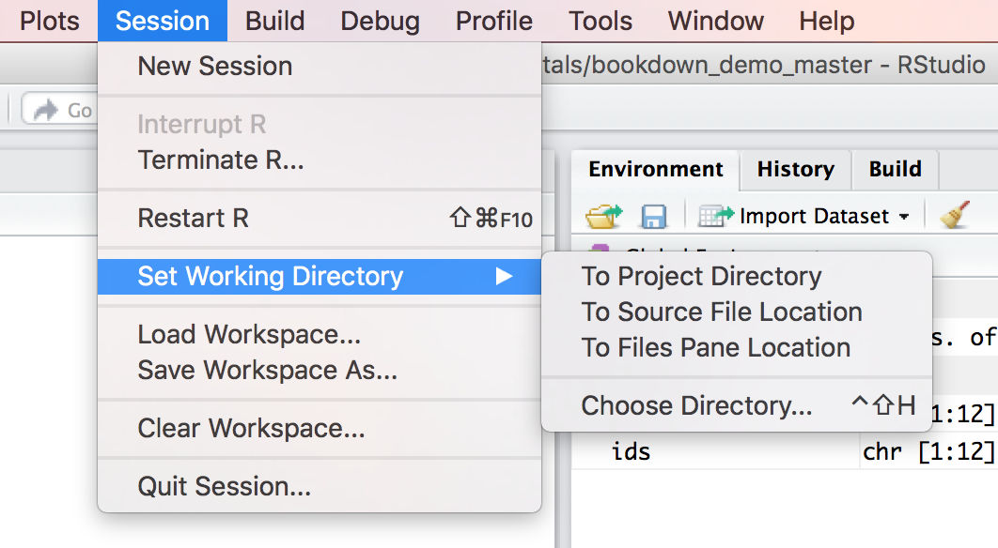
Setting your working directory
You can set your working directory in RStudio by going to Session > Set Working Directory > Choose Directory,

Slide 9
Downloading and importing data
In R, you can import data files that you created in Excel, MiniTab, SPSS, Stata, and many more programs.
However, the cleanest and easiest way to import data is as a CSV file.
“CSV stands for comma-separated values or character-separated values. This file format stores tabular data (numbers and text) in plain-text form. Plain text means that the file is a sequence of characters, with no data that has to be interpreted instead, as binary numbers.
A CSV file consists of any number of records, separated by line breaks of some kind; each record consists of fields, separated by some other character or string, most commonly a literal comma or tab. Usually, all records have an identical sequence of fields ((“Comma Separated Values” 2018)).

Slide 10
Downloading Data
Before we can import a file, we need to have a file to import. Let’s use a file from NYC Open data on Sidewalk Cafes. You can download the dataset from:
http://becomingvisual.com/rfundamentals/Sidewalk_Cafes.csv
Find the Sidewalk_Cafe.csv file that you downloaded (you can probably find it in your Downloads folder on your computer) and move it to your mydata folder on your desktop.

Slide 11
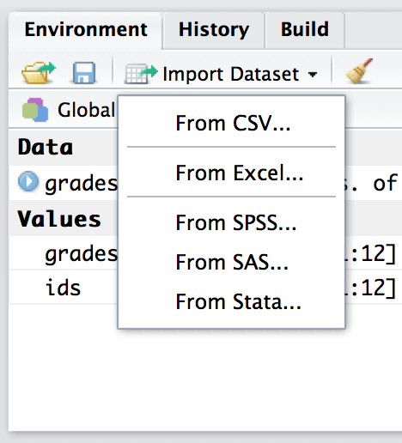
Importing a dataset
Your workspace. In RStudio the upper right quadrant is called your workspace. To import a CSV file simply click on the import dataset button in your workspace.

Slide 12
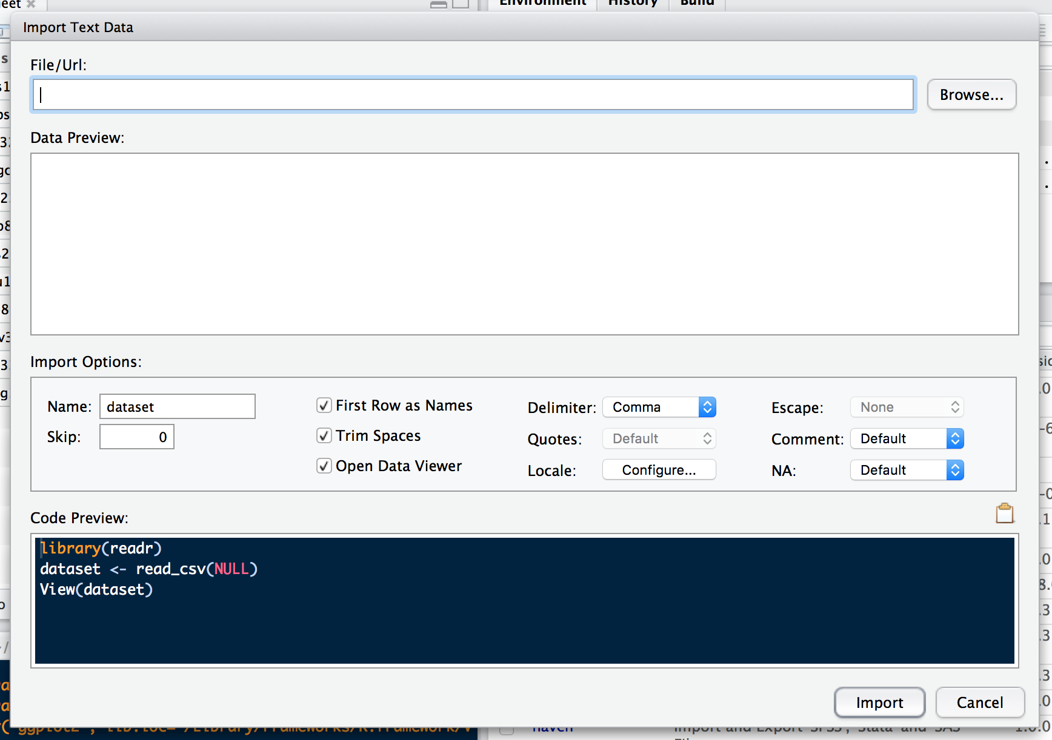
and

Slide 13
Importing Dataset
Name. First, you can name your dataset. There is already a default name given. Let’s replace it with sidewalk.
Heading. Select yes since the first row in the dataset contains the column headings. These include Entity.Type, License Number, Sidewalk.Cafe.Type., etc. If you do not select yes to heading, R will create a default header using V’s (e.g. V1, V2, V3). This works well if you do not have a header, but in our case we do and we don’t want R to create a header for us. If we, selected no, our first row of data would contain the column names, such as Entity.Type, etc.

Slide 14
Importing Dataset
Separator. This is the delimited for your CSV. In this case, the delimiter is a comma. You can see this in the input file window. Other options include whitespace, tab, or a semicolon.
Decimal. If there are decimal points in your data, select period to use the period character for the decimal point. This is the default setting and you can keep it set to period for our purposes. If needed, select comma to encode decimal points into commas.
Quote. If there are single quotes in your data, you can select to have them encoded as double quotes, single quotes, or none. You can keep the default setting.

Slide 15
Importing Dataset
The command to view the file in the source window is:
View(sidewalk)
Change the data to a data type called a data.frame.
sidewalk<-data.frame(sidewalk)
We check this by using the class( ) function we learned earlier.
class(sidewalk)
## [1] "data.frame“
length(sidewalk$Entity.Type)
## [1] 1008

Slide 16
Working with missing data
Let’s do a little more with this data frame. Let’s say you wanted to know the average or the mean square footage for sidewalk cafes in NYC. You can use a simple function called mean( ) to compute this value for the variable Lic.Area.Sq.Ft.
mean(sidewalk$Lic.Area.Sq.Ft)
## [1] NA

Slide 17
Let’s just view the sidewalk$Lic.Area.Sq.Ft variable.
View(sidewalk$Lic.Area.Sq.Ft)
The function mean( ) cannot compute the calculation because NA is not a number. Only numbers can be used to compute the mean. This is why the value of NA was returned from R.
We need to remove the NA values or tell R to ignore them when computing the mean. We are going to do this by passing in a parameter to the mean( ) function called na.rm=TRUE. This will indicate that the NA values should be stripped before the computation proceeds.
mean(sidewalk$Lic.Area.Sq.Ft, na.rm=TRUE)
## [1] 258.6475

Slide 18
Extracting a subset of a data frame
Subsetting your data frame is useful if you want to select different variables within the data frame (i.e., keep only some of the columns) or a subset of observations (i.e., keep only some of the rows).
Using the $ operator
If you only want to extract one column of your data frame you can use the $ operator. In the example below, we just called the column Address.Zip.Code from the sidewalk data frame and assigned it to a variable called zipcode. I just included a snippet of the values of zipcode.
zipcode = sidewalk$Address.Zip.Code zipcode

Slide 19
Using square brackets
We can reference rows and columns of a data frame or vector using [ ].
The format for usage is as follows: Data frame [rows, columns]
If we wanted the first 2 rows from sidewalk and 5th through 12th variables, Entity.Name through Location.1 we could write the following: sidewalk[1:2, 5:12]

Slide 20
Using square brackets
If using numbers for variable (column) names (e.g. 3, 5) become too abstract, you can always pass in the actual name of the column. See the example below.
sidewalk[1:100, c(“Sidewalk.Cafe.Type”, “Entity.Name”)]
Finally, there are times where you want to display all the rows or all of the columns. This can be done by simply leaving the row or column value blank (but keep the comma to separate the row and column parameters). See below for an example that displays all the rows, but only two columns.
sidewalk[, c(“Sidewalk.Cafe.Type”, “Entity.Name”)]

Slide 21
Writing R scripts
Creating an R script is an alternative to typing your R commands in the console window. An R script is simply a text file in which your R commands are stored in a logical sequence.
There are many advantages to writing your R code as an R script file.
(1) You can save your work
(2) You reuse your code
(3) You can document your work
(4) You can share your work with others
You can move beyond writing one line of code at a time
In RStudio you can easily create an R script by going to the file menu > New > R Script. This will bring up a blank document in the source pane. (See Figure )
Save your script as sidewalk_cafes_script.R by going to File > Save As > sidewalk_cafes_script.R.

Slide 22
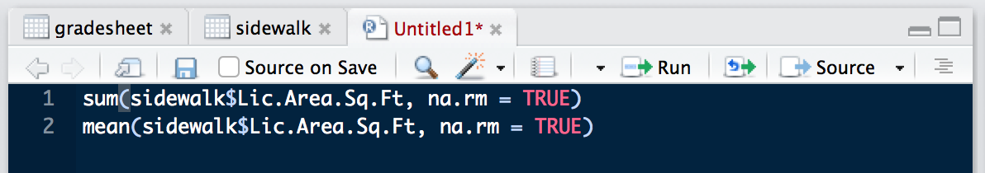

Slide 23
In your R script, you’ll notice the number 1. This indicates line 1 in the file. You can begin typing your R commands in this file. Type the commands you see in Figure. Then save your file by going to File > Save.
The first line in the script uses a function called sum( ) to add up Lic.Area.Sq.Ft column of data. You’ll notice that we passed in na.rm=TRUE to ensure that the NAs were not included in the sum calculation.
(Note: These commands will not be executed until you actually run the script.)

Slide 24
Running R scripts
There are two ways to run your R script. Note: Any changes made to the script need to be saved before running it.
Option 1. If your script is stored in your working directory you can type the following in the console:
source (“sidewalk_cafes_script.R”)
If you copied and pasted this code and received this error: Error: unexpected input in “source (ð” it is due to the smart quotes that MS Word uses. Use single quotes or replace the double quotes.
However, this method requires you to be very explicit about printing out values to the console. If you ran the command above, you’ll notice the sum and mean were not printed. You would have to modify your file to include the print( ) function.

Slide 25
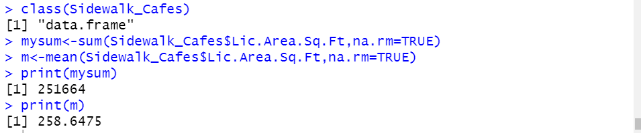
See lines 8 and 12 in Figure . You’ll notice that we are calling a function within a function. We are passing the output of the sum( ) function to the print( ) function. (See Figure )for the output in the console. This is a shortcut. It’s possible to first compute the sum, then print. Such as:
mysum <- sum(sidewalk$Lic.Area.Sq.Ft, na.rm=TRUE) print(mysum)

Slide 26
Running R scripts
Option 2. You can use RStudio to execute your code. I prefer this method. You can execute your code line by line by putting the cursor on the line number and pressing the run button in the source window until you reach the end of the script.
To run the full script, highlight the entire script and press run.
For the rest of this course, we will be using R scripts and R Markdown documents (more on that later) rather the console to execute commands in R.

Slide 27
Adding comments and documentation
Comments are used to document your code in R and all programming languages. It is best practice to include comments in your code. This ensures that if someone else tries to read your script they can interpret it. This is also to help you interpret your code when you return to it days, weeks or months later.
The comment character, # tells R to ignore everything written to the right of the #. We use the # for each line we would use for commenting our code. In RStudio, the color of the text will change to indicate that you are writing a comment. In the example below, the commented text is in blue. The R code is in white. The functions and operators are in orange, and the logical data types are in pink.

Slide 28
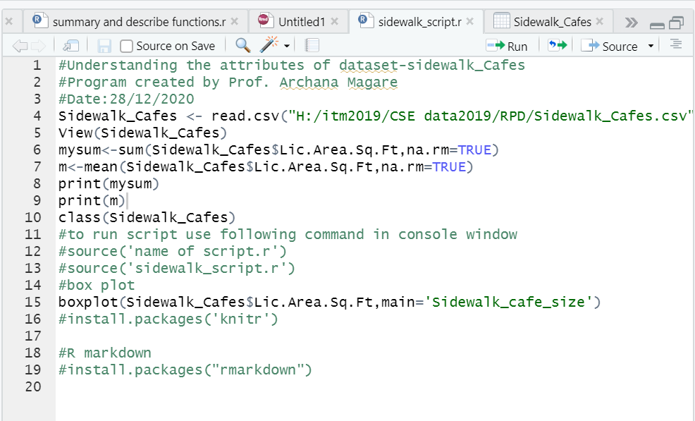

Slide 29
Creating reports
Let’s say you have a dataset that comes in the same format every week, such as a sales report. Wouldn’t it be nice to simply produce a report with every week with a single click, updated with all calculations and visualizations? knitr is an R package that makes it easy to achieve this goal. You can show others what you are doing in R by publishing your code and output to a web page, Word Document, or PDF file.
As an aside - We won’t be covering it here, but LaTeX is a very powerful, open source package, capable of consistently formatting very complex text, such as equations for professional publication. If you want to use knitr to create a PDF document, you will need LaTeX installed.

Slide 30
Creating reports
To create dynamic reports, follow along with the instructions below.
a. Install knitr
Begin by installing the knitr package along with any identified dependencies in Rstudio.
b. Modify your RScript
Working with your sidewalk_cafes_script.R add a simple box plot using the code on line 14.

Slide 31
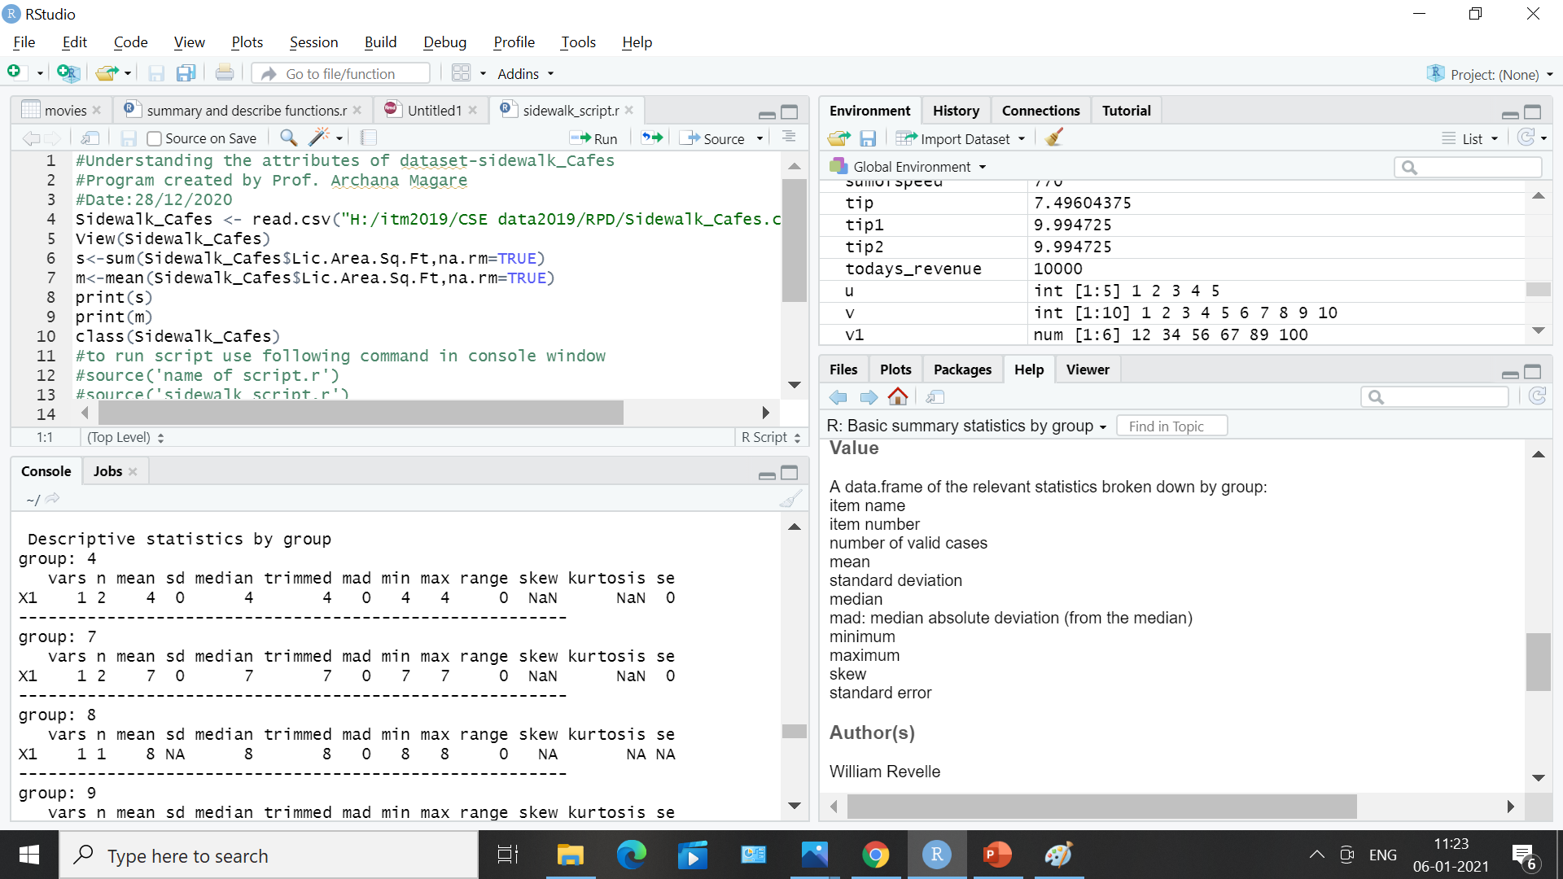

Slide 32
Create a MS Word document from your R script
Click on the “Compile Report” button (You can also chose the “Compile Report” command from the File menu).
You will be presented with a menu to chose your output format (HTML, Word, or PDF. If you chose PDF, you will need to have a specific version of LaTeX installed depending on your operating system, the error message in the console will tell you which version you would need. For now, let’s choose MS Word.
The compiled notebook from the RScript. This format makes it easy to add explanatory notes. The plot is also created and included. Notice that the output of each command is denoted with ## interspersed with the R code. That is helpful since any line that begins with # is treated as a comment. So anyone who wants to run the code can copy and paste then entire block of text, including the output into the console, and the code will be executed, but the old output will be ignored.

Slide 33
Creating an R Markdown File
The above example demonstrated how to publish your R script in a readable format, but it still has some drawbacks. Suppose you want to create a report that updates automatically? The above method will still be easier than manually creating the report each time, but formatting and adding comments will still have to be done manually every time the report is run. Creating an R Markdown file will allow us to automate the process of data manipulation, report creation, and formatting.

Slide 34
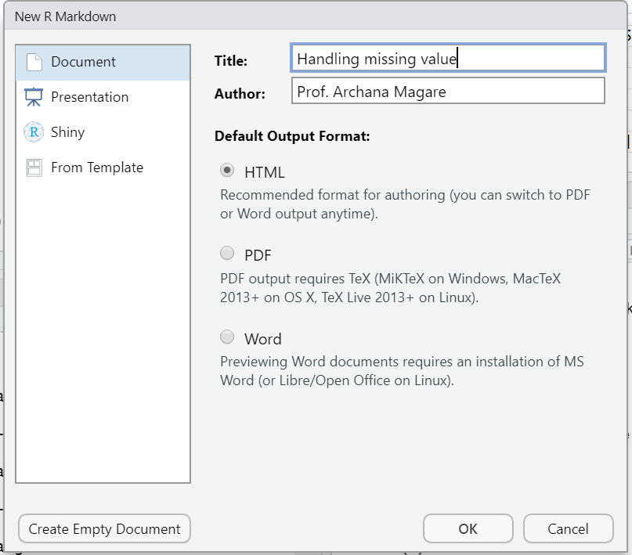
Try it – A short activity
To get started go to the File menu, click New File > R Markdown as shown in Figure.
(Note: The first time you do this you may be prompted to install several packages.)

Slide 35
Title and Author: Enter a name for the file, and your name. Select HTML as the default output format. Click OK.
RStudio will create a Markdown file. This document will allow you to create a file using simple plain text, which can then be easily converted into HTML, Word, or PDF. You can easily embed your R code and output. The file that RStudio creates will also be pre-populated with example Markdown syntax file using one of the sample data sets embedded in R.

Slide 36
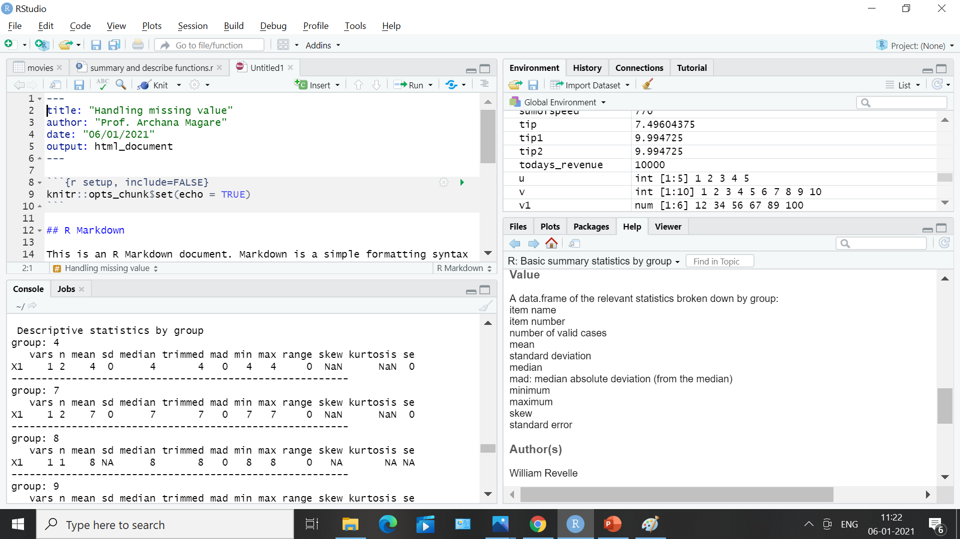

Slide 37
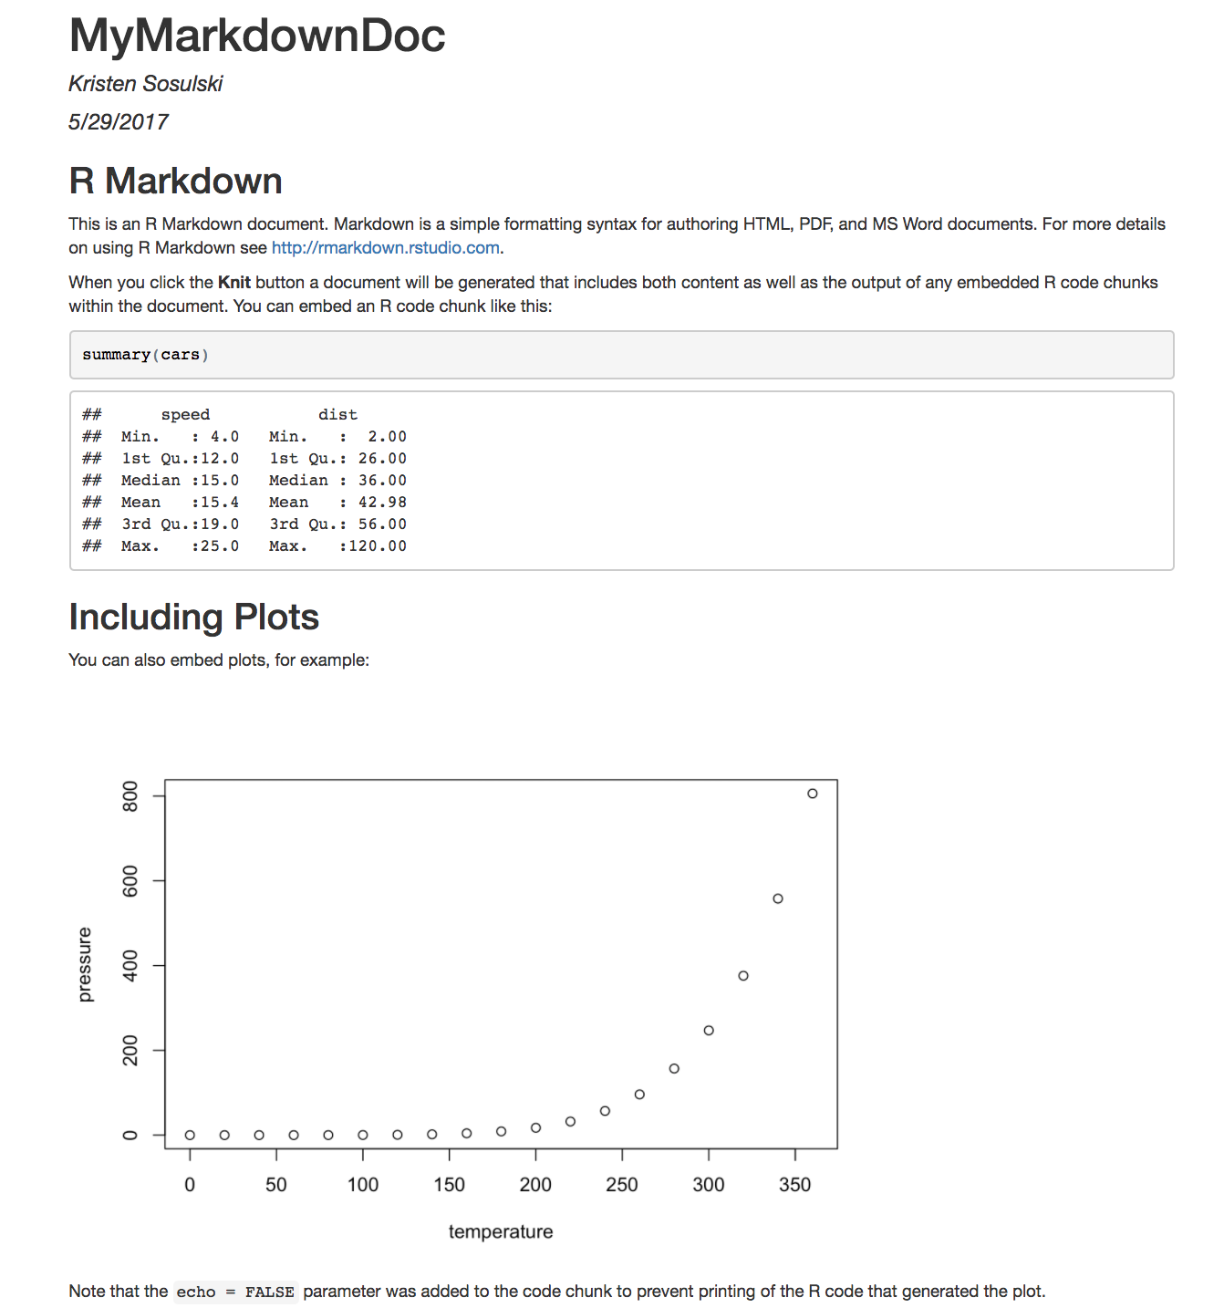

To see the HTML file, select

Slide 38
R Commands
rm(list=ls( )) removes all objects from your R environment
library( ) returns all of the packages installed in your version of R. When a package is included as a parameter e.g. library(foreign) this loads the package for use
detach( ) unloads a package from use
find( ) function returns the library origin of the object, function, operator, etc. of the parameter
read_csv( ) imports a CSV file into R
setwd( ) function sets the working directory in R

Slide 39
R Commands
na.rm=TRUE parameter removes all NAs from a function before the function is executed.
sum( ) function returns the sum or total
mean( ) function returns the arithmetic mean
source( ) function runs an R script
print( ) is a function to explicitly print output to the console.

Slide 40
R Commands
# are used for single line comments
$ operator is used to extract a variable from a data frame.
subset(x =, subset =, select =) is used for extracting certain rows and/or columns from a data frame
square brackets can be used for extracting specific rows and columns.

Slide 41
References
Sosulski, K. (2018). R Fundamentals.
Wickham, H. & Grolemund, G. (2018). for Data Science. O’Reilly: New York
Norman Matloff(2011),The Art of R Programming: A Tour of Statistical Software Design ,No Starch Press

